Slide 1

PUB SUMMIT EAG 2026 market UPDATE AND PAYMENT METHOD REVIEW
Simon Barff
MANAGING DIRECTOR - CLMS

Slide 2

INTRODUCTION
At CLMS, we specialise in the collection, audit, analysis and reporting of income and performance data for over 35k pay to play machines, from over 40 suppliers across 40+ companies in the pub retail sector.
Notes:
Based on our insights into the market we have put together the following market overview. While some of these slides include assumptions and estimates they are all based around the largest sample size of data in this sector.
m

Slide 3
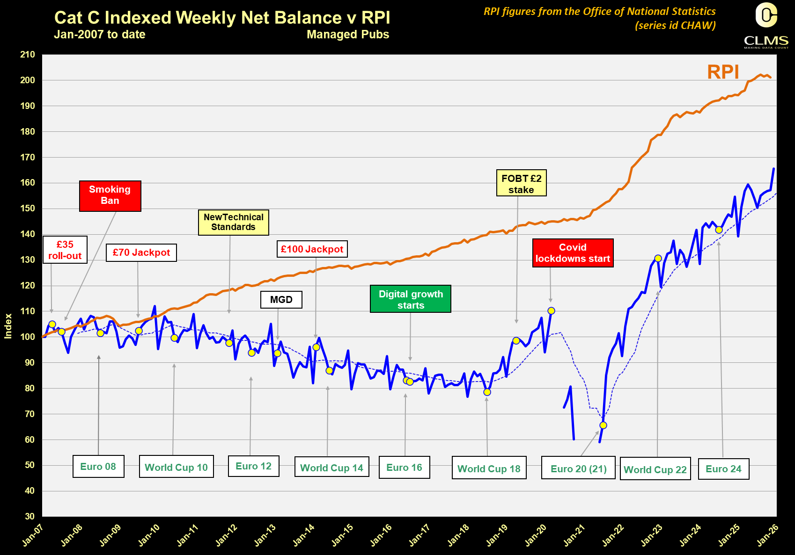


Slide 4
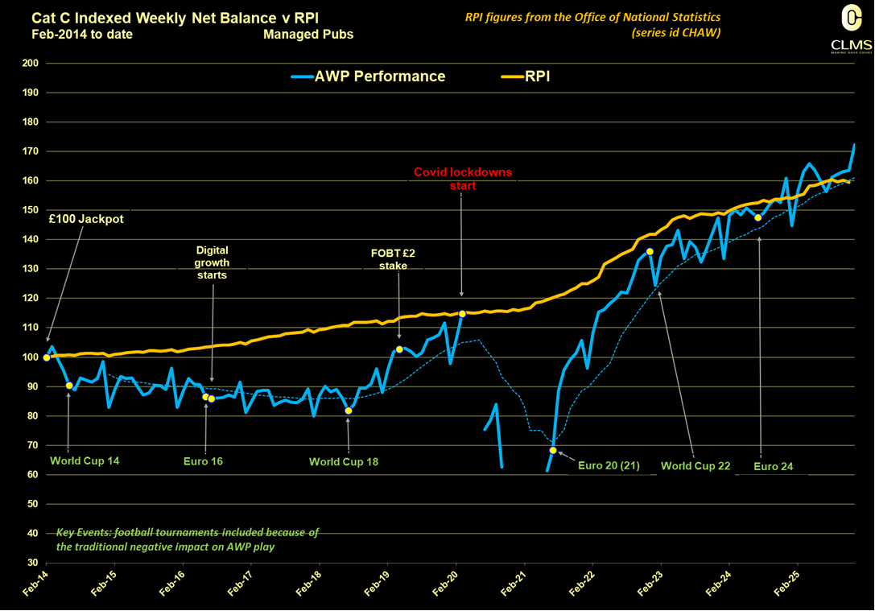

Slide 5
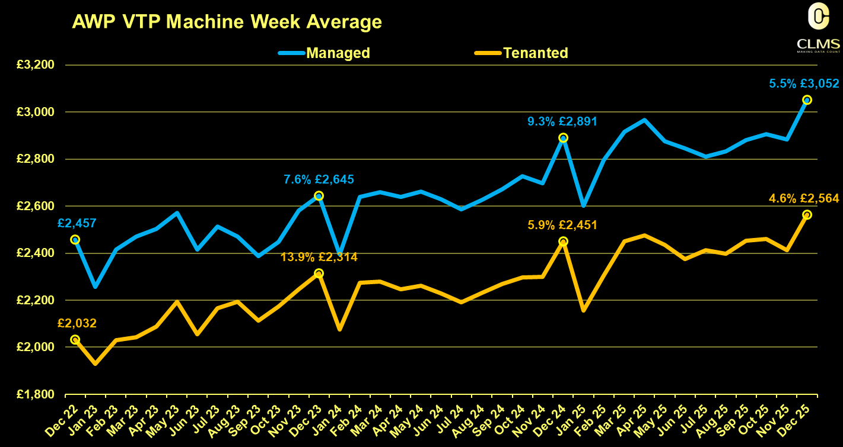
£ Value of Plays Per Sector
£2618
£2696 +3%
£2910 +8%
£2388
£2528 +6%
£2556 +1%

Slide 6
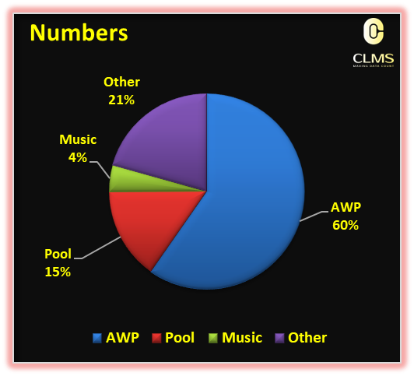
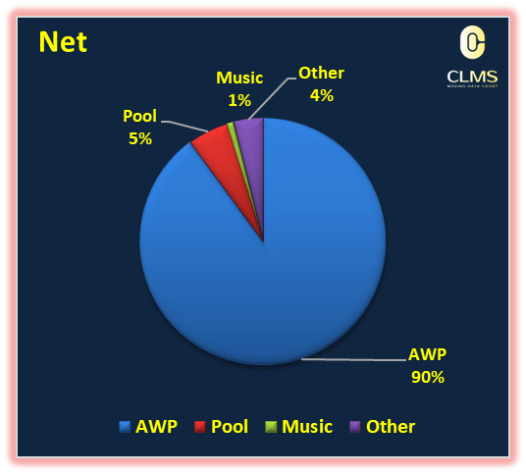
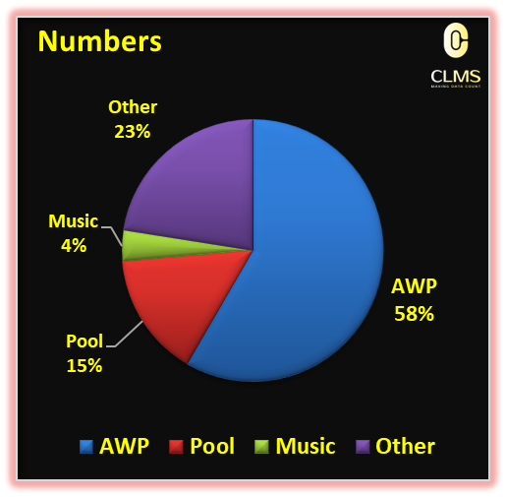
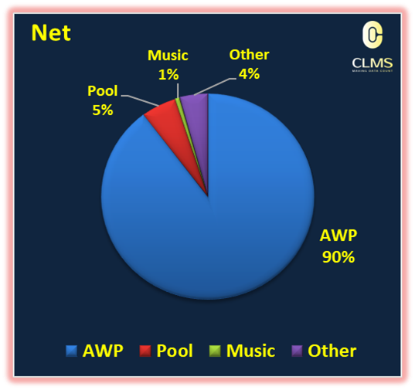

PUB MARKET OVERVIEW

Slide 7
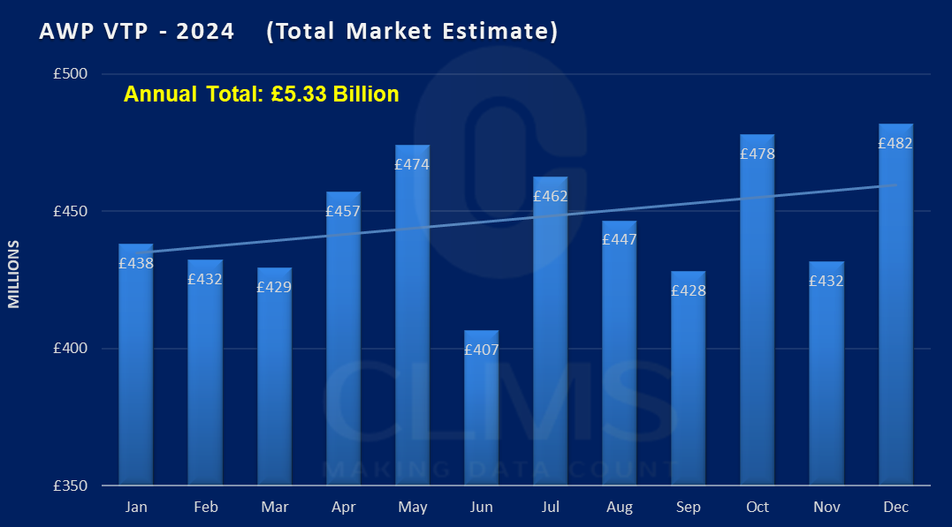
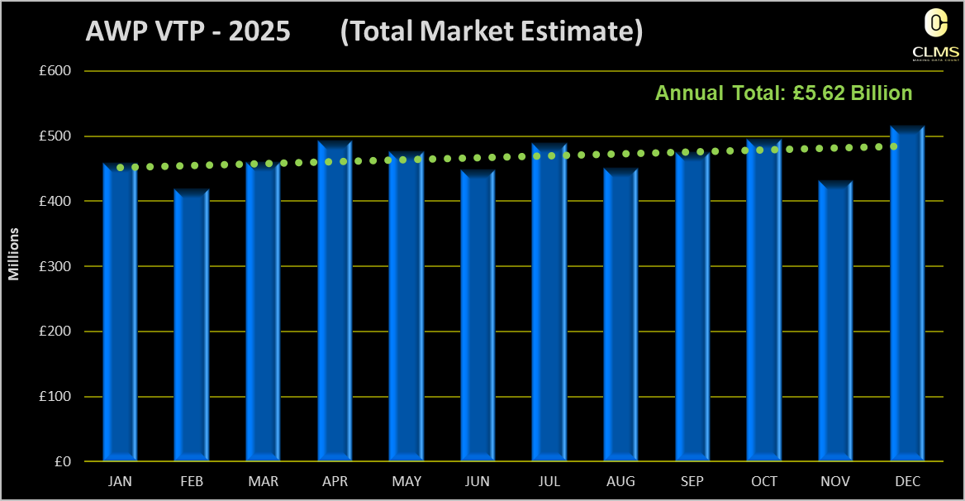
TUNROVER & NET INCOME

Slide 8
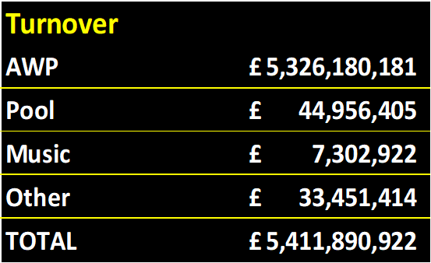
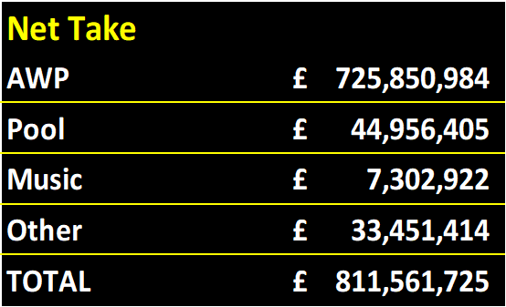
TUNROVER & NET INCOME

Slide 9
PAYMENT METHOD REVIEW

Slide 10
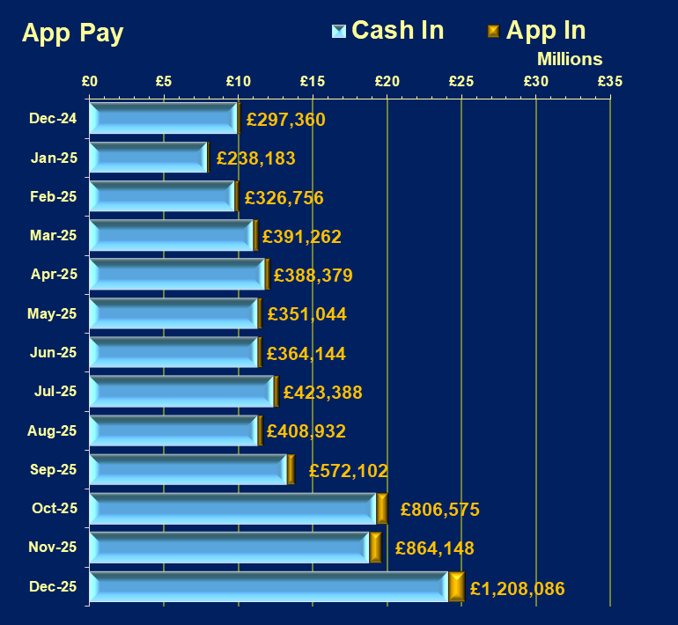
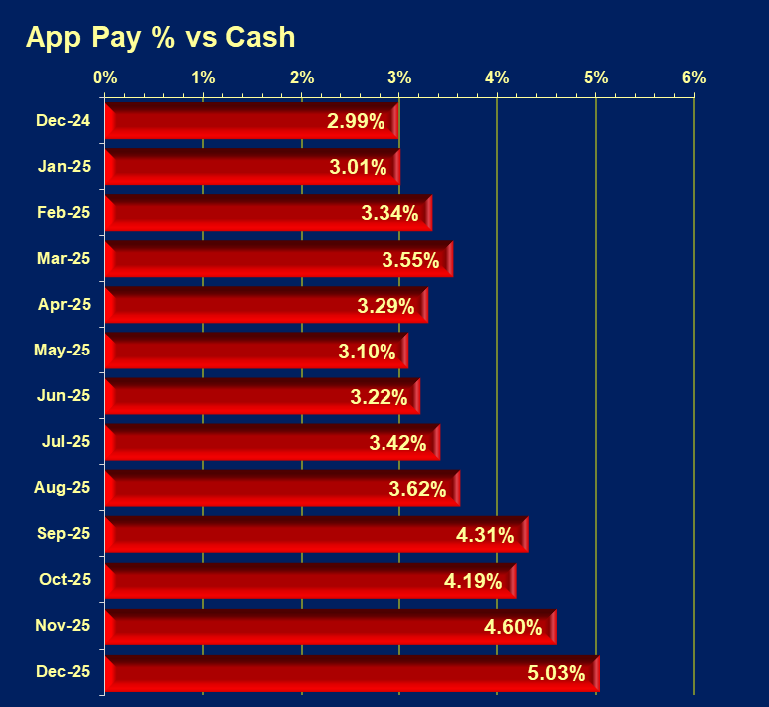

AWP APP PLAY traction
FIGURES ARE BASED ON CLMS CUSTOMER DATA ONLY – FROM 1ST NOV

Slide 11
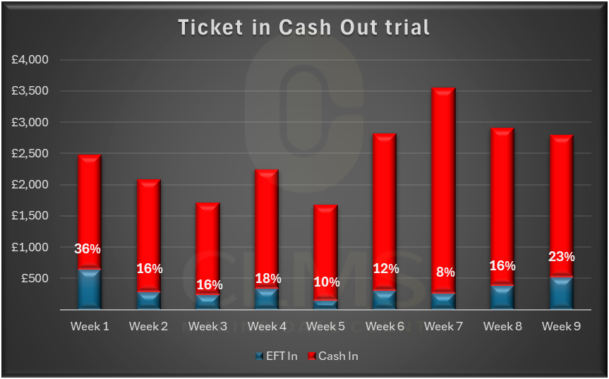
AWP TICKET IN TRIAL

Slide 12
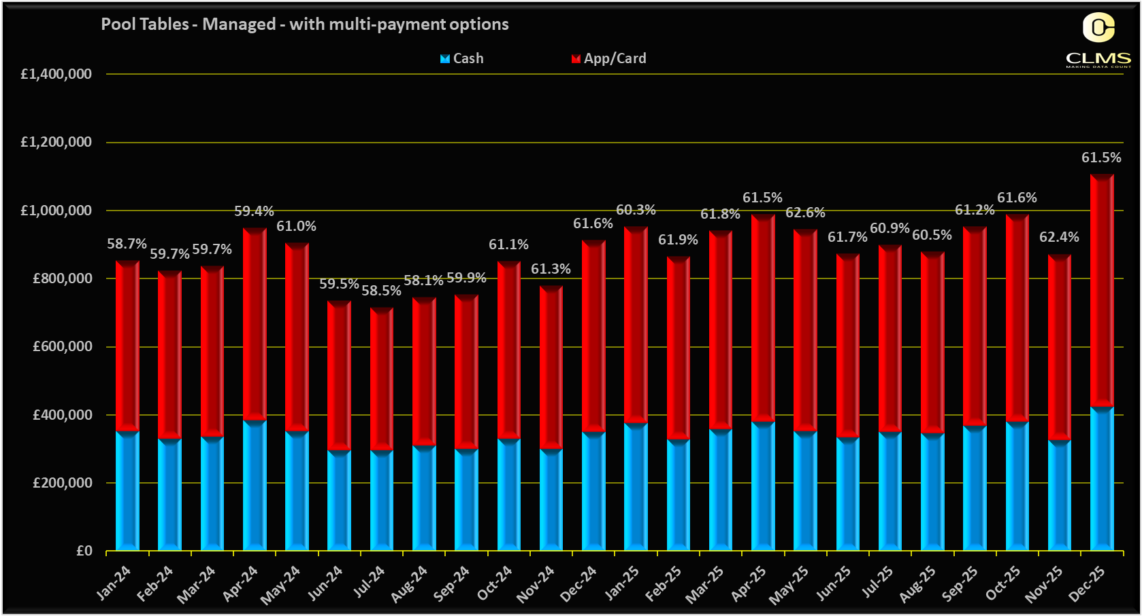
Pool Table DUAL PAYMENT – Transaction VALUE
79.8% of all pool tables are now dual pay – Managed up from 62% in 24

Slide 13
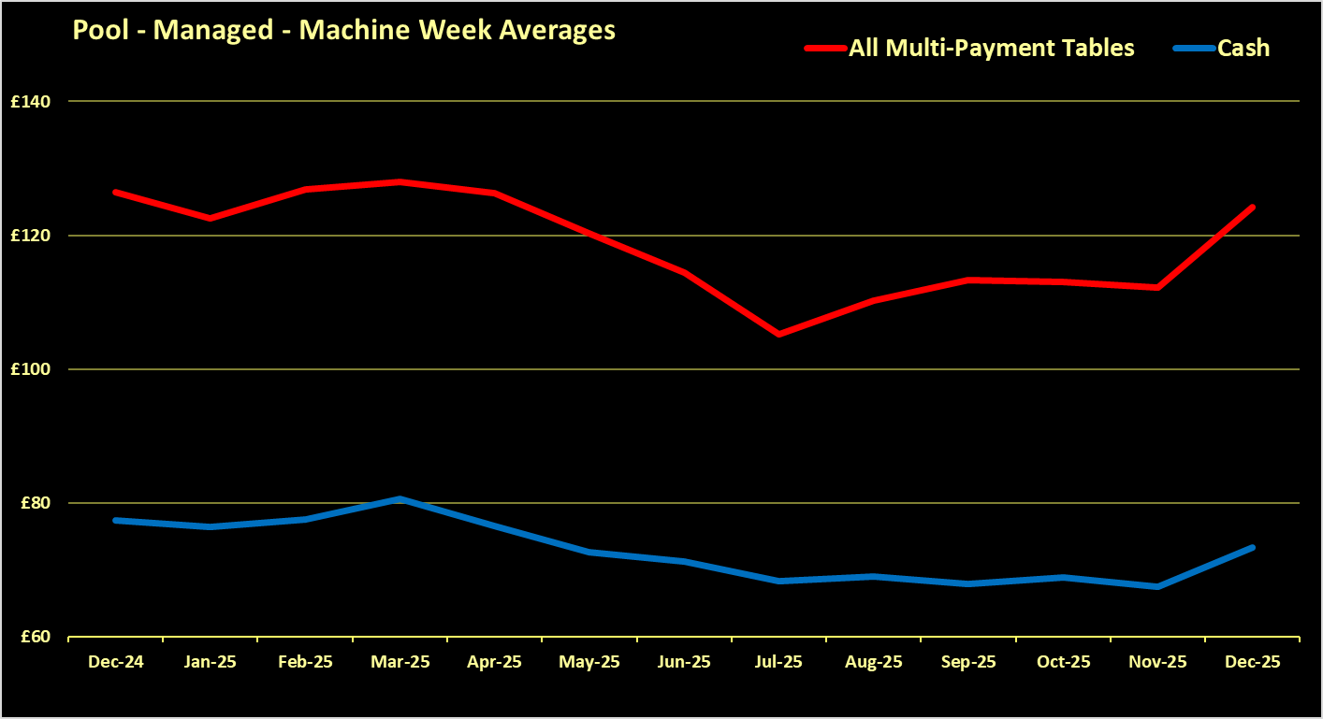
DUAL PAYMENT – POOL

Slide 14

£ INCOME LEVELS FROM OTHER PRODUCT TYPES

Slide 15
THANK YOU
Simon Barff
simonbarff@clms.co.uk

Slide 16
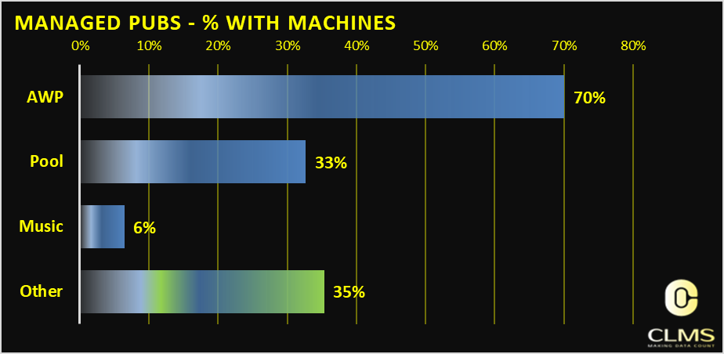
PUB MARKET OVERVIEW

Slide 17
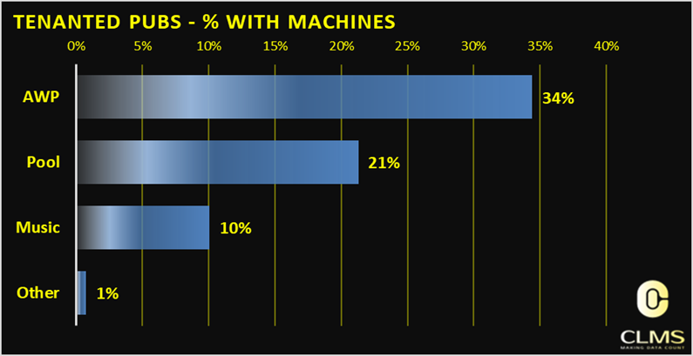
PUB MARKET OVERVIEW

Slide 18
